Slide 1
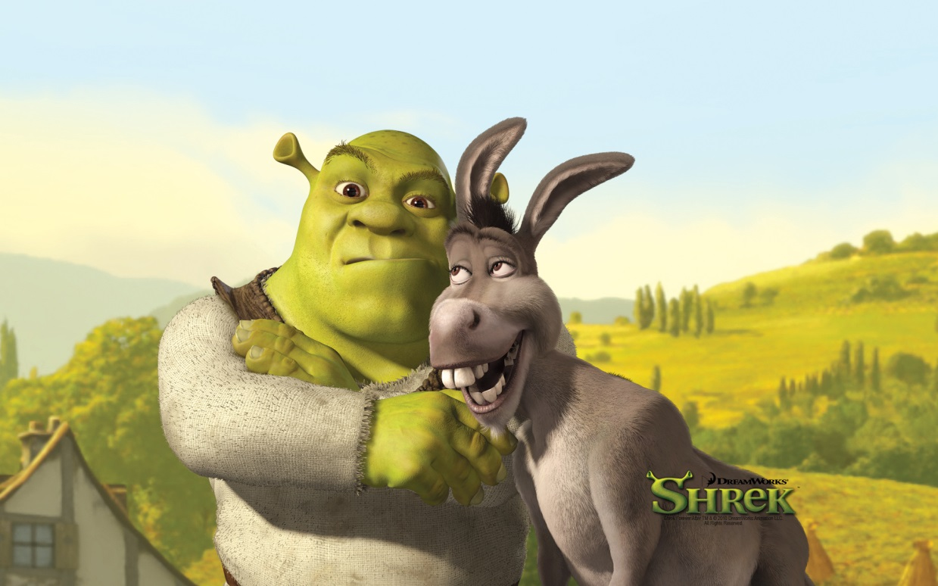
Shrek The Hero’s Journey

Slide 2
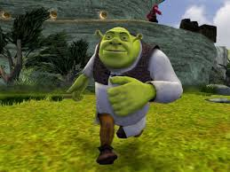
The Hero’s Journey
Many myths, legends, and stories all have the same structure of events which Joseph Campbell called The Hero’s Journey.
Ordinary World
Meeting with the Mentor
Call to Adventure
Journey
The Road Back
The Return

Slide 3
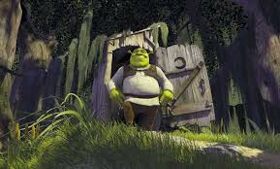
Ordinary World
The hero and the setting are ordinary as the story begins.
As the story begins, Shrek is living in his swamp, wanting to be left alone, and generally disliked by all, but he’s gotten used to it. Then Donkey comes into his life…

Slide 4
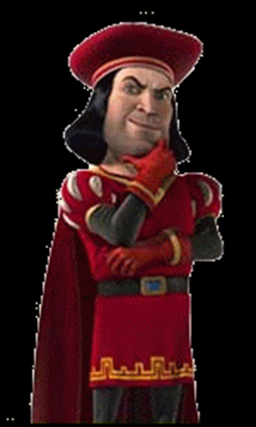
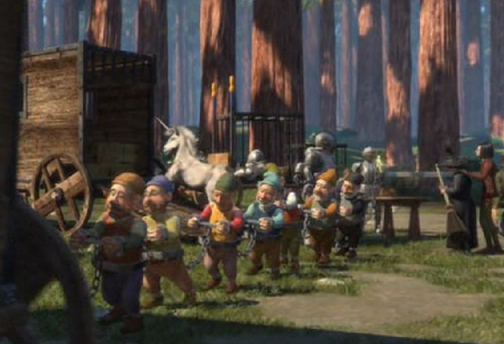
Call to Adventure
The hero is presented with a problem, challenge, or adventure.
After the fairy tale creatures invade his swamp, our hero is forced to visit Lord Farquaad and is given his “quest”.

Slide 5
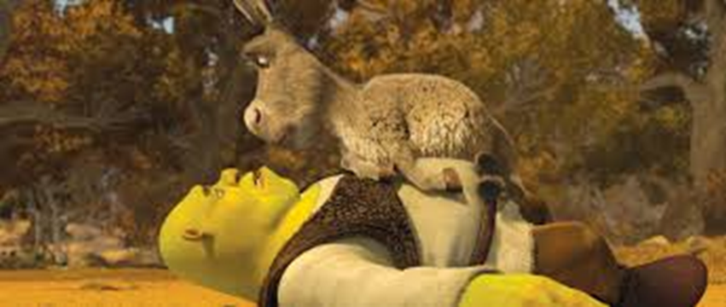
Meeting with the Mentor
The hero meets a mentor to gain confidence, advice, or training to face the adventure. The mentor also helps the hero to learn the lesson.
Shrek meets Donkey who befriends him and teaches him (in a humorous way).

Slide 6
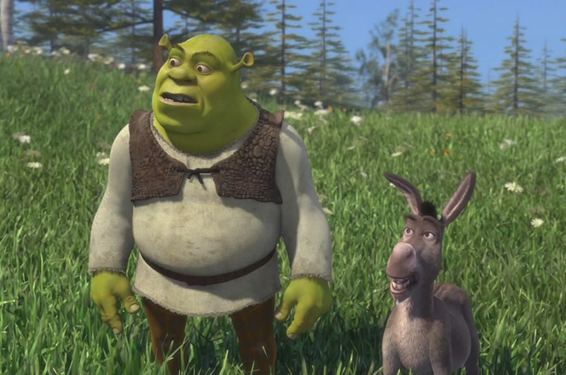
Journey
These are the main events in the story. This includes the main conflicts and the climax (the most exciting part of the story)
Shrek, and his companion Donkey, embark on the quest. Shrek has various obstacles to overcome in order to finish the quest.

Slide 7
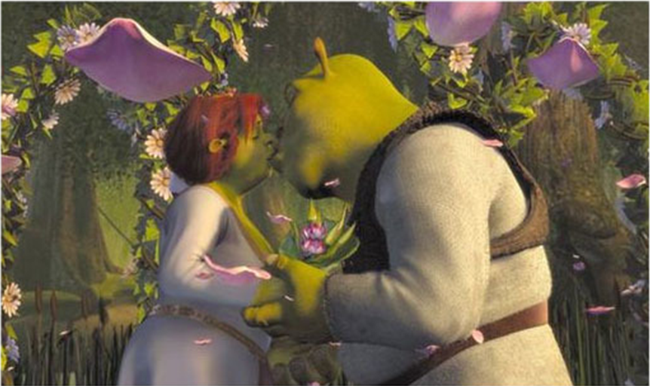
The Road Back
The hero must return to the ordinary world.
The two ogres marry and live happily ever after in the swamp.

Slide 8
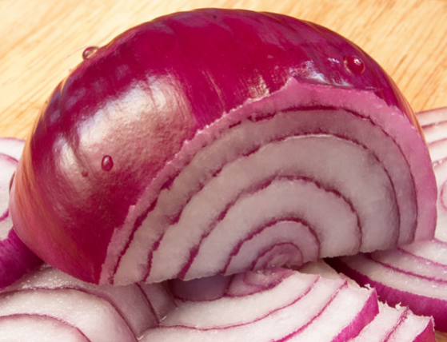
The Return
The hero returns from the journey and learns a valuable lesson about life
Shrek learns that you can’t judge people based on how they look. If Shrek can find true love, anyone can.
Layers of an onion!!!

Slide 9
ASSIGNMENT IN ENGLISH SPIRAL
List your own favorite hero’s journey from a book, movie, myth, folktale, story, etc.
Or CHOOSE ONE:
Star Wars
Avengers
Harry Potter
The Hunger Games
The Wizard of Oz
Divergent
Jaws
Jumanji
Aladdin
Video Game?........

