Slide 1
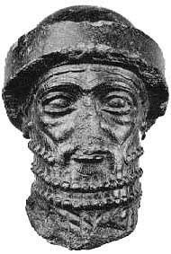
Code of Hammurabi

Slide 2
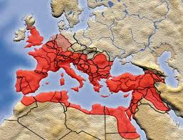
Empire
Many lands under one ruler

Slide 3
Sargon
Conquered Mesopotamia and made the world’s first empire.
2340 BCE
Lasted 200 years
Someone invaded

Slide 4
Hammurabi
1792 BCE
King of Babylon
Took over Mesopotamia
Best know for his laws or “code”

Slide 5
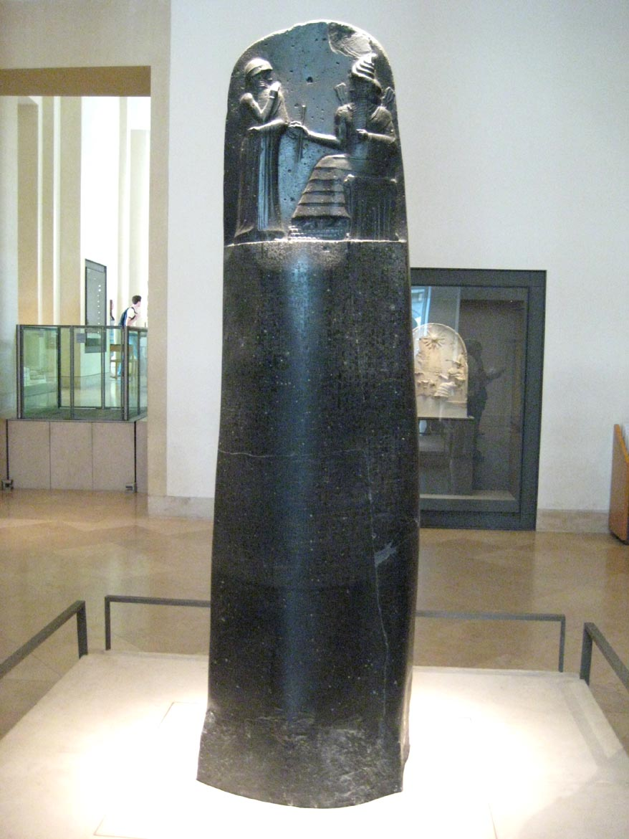
The Laws of Hammurabi are the longest and best organized of the law collections that survive from ancient Mesopotamia. King Hammurabi, who ruled from 1792-1750 B.C., had the laws inscribed on stone which he placed in various temples throughout his realm. This stands almost seven-and-a-half feet tall.

Slide 6
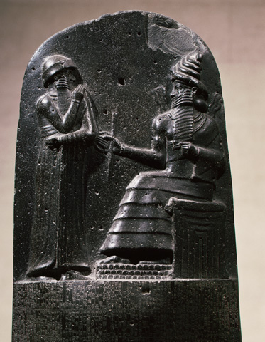
At the top of the stone, King Hammurabi stands before the sun god Shamash, the Mesopotamian god of justice, who is seated on his throne. Shamash gives Hammurabi the rod and ring, symbols of kingship and divine justice, thus reinforcing the ancient Mesopotamian belief that laws came from the gods.

Slide 7
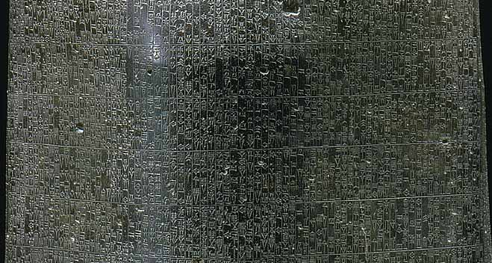
Below this scene is the law collection itself, mainly comprised of a compilation of legal verdicts describing specific offenses and the penalties to be enforced in particular situations

Slide 8
Code of Hammurabi
First, there is a lengthy prologue, stressing the gods' appointment of Hammurabi as the ruler of his people.
Hammurabi's role was to act as guardian and protector of the weak and powerless, and to pay care and attention to the specific needs of the patron deities of the many cities incorporated into his realm.
Following the laws is an epilogue describing the king as the military leader who brings peace to his subjects. It explicitly states that these laws were inscribed on a stela and publicly displayed in order to testify to Hammurabi's righteous and just rule, to bring consolation to anyone seeking justice, and to serve as an example for future rulers.

Slide 9
He based the laws on the word of the gods
He claimed that the gods told him to create laws that applied to everyone.
The laws would NEVER be changed or they were “set in stone”
The law covered many situations:
Trade, work payment, stealing, marriage

