Slide 1
Welcome to Back to School Night!
LANGUAGE ARTS – SOCIAL STUDIES
Art and Character Building Elective
Miss Ashley Boutell
Room 31
USE THE INDEX CARDS PROVIDED TO:
-write a kind note to your child for me to give to them in class
-ask any questions or take notes

Slide 2
Miss Boutell English/Social Studies Email: aboutell@conejousd.org (fastest way to contact me) School phone: (805) 492- 3538 x1231

Slide 3
About the Teacher Grew up in the Conejo Valley. B.A. in Liberal Arts w/emphasis in Visual and Performing Arts from CSUCI. Teaching Credential - CLU. M.A. in Education - CLU. 8th year teaching – 5th at l.c.m.s. Passionate about Teaching! Students are my top priority! Firm but Fair- Your child will be held to high standards and will succeed!

Slide 4
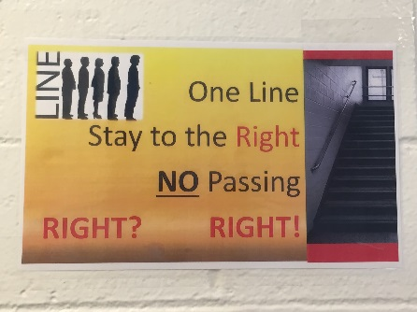
CHAMPS
* Emphasizes positive interactions
between students and staff
* Positive approach to classroom
management
* L.C. is a CHAMPS model school

Slide 5
Core Literature: Wonder Tuck Everlasting * Students may purchase their own copy for note taking and annotating (if they wish) *Learning and showing through Listening, reading, speaking, and writing!
* Short Stories, Poetry, Greek/Roman Mythology
* The Odyssey (a simplified version)
* Shakespeare (a simplified version)
* Literature Anthologies - New Textbook

Slide 6
* One type of writing (essay) per trimester * Always work on essays in class * teacher assistance * Peer reviews and editing * 5-7 school days to work on their writing assignments in class * Students will not have many other homework assignments given at that time to allow them to concentrate on their writing practice writing every day(Eng.spirals) Three main formats: * Narrative - descriptive * Informative – summarize, synthesize * Argumentative – prove, support
Essays

Slide 7
* Students will periodically be given the opportunity to work in groups and pairs to complete projects and assignments. *Speaking academically is a skill that needs to be practiced. * Encourages teamwork & peer collaboration. * The students will conduct research and create a unique project based on a Greek God or Goddess of their choice. *Graded individually - fair
Group Projects and Research Report

Slide 8
Ancient World: *Early Humans to Ancient Rome. *Focus on analysis of Primary and Secondary Sources. *Focus on “Big Ideas” and “Big Questions”. *Critical thinking skills Skills: *Organization, Responsibility, Public Speaking, Critical Thinking, Thinking like a Historian, Working in Groups. *Skills specifically learned in their Careers Class *Historical Spiral
Social Studies

Slide 9
* For all large tests, study guides are provided. * Spelling Tests *Students who receive a 100% on the pre-test will automatically receive a 100% on the test and will have alternative words for homework assignments that week. *Latin Root Words Vocabulary *Daily Language Review(grammar) * All grades are recorded on Zangle/Q.
Tests and Quizzes

Slide 10
* If your student is struggling, I will pull them out for the intervention class *twice a week – 25 minutes each *Boost grades, corrections, catch up, re-teach *provides a more one-on-one and small group help
Intervention (R.T.I.)

Slide 11
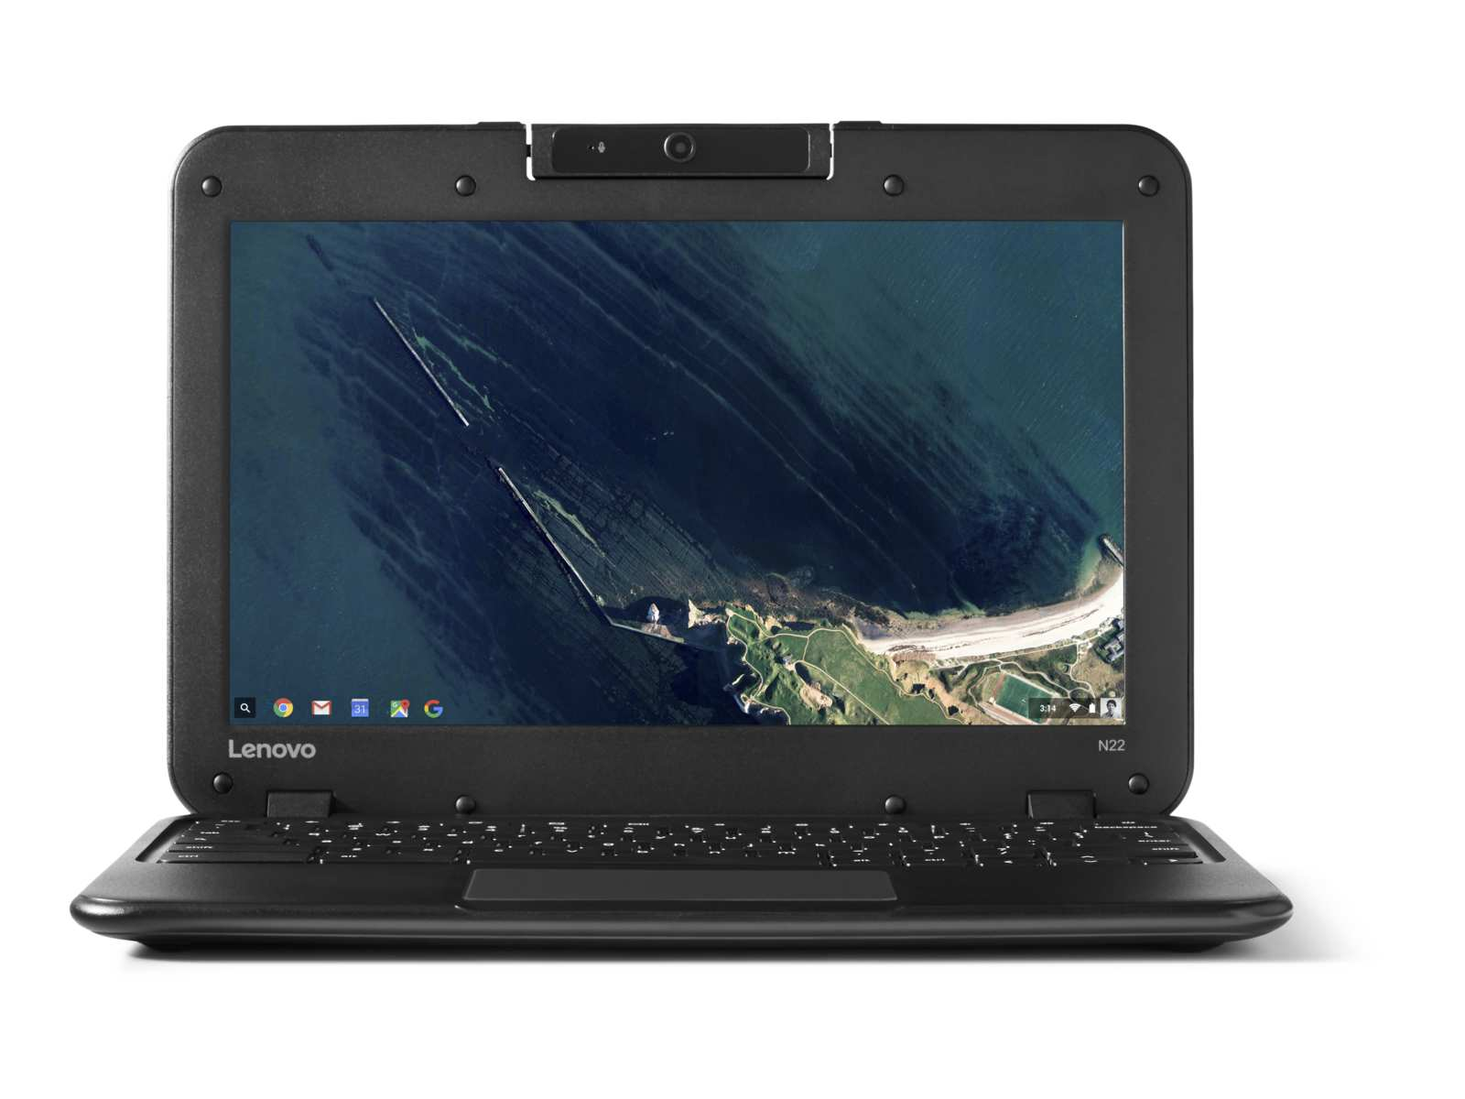
ID#@learn.conejousd.net
* One-to-One Technology
* Google Classroom
* Assign/Turn In Work

Slide 12
New English Textbook!
No English textbook at home

Slide 13
* Late Homework: *Will complete at lunch (detention) *Same day = partial credit * Late Big Projects = dramatic point reduction * 10% grade deduction for every school day assignment is late. * Classwork & homework can be found on: www.aboutell.weebly.com * If your student is absent, please encourage him/her to visit the website to find what class work and homework they missed prior to coming back to class. *all worksheets found in absent bin – all electronic notes/sheets found on website
Homework

Slide 14
*Check Agenda Book and/or Website Daily. www.aboutell.weebly.com * Provide an effective learning environment. * Check the Los Cerritos website for information on what is happening on campus. * Notify me when there is a problem (email works best). *Check Zangle/Q to ensure your student is staying up to date with their assignments.
What You Can Do

Slide 15
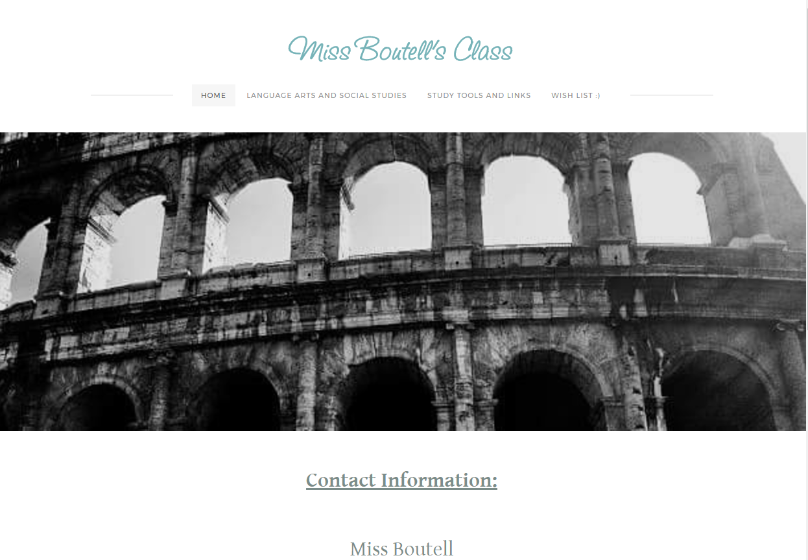

Slide 16
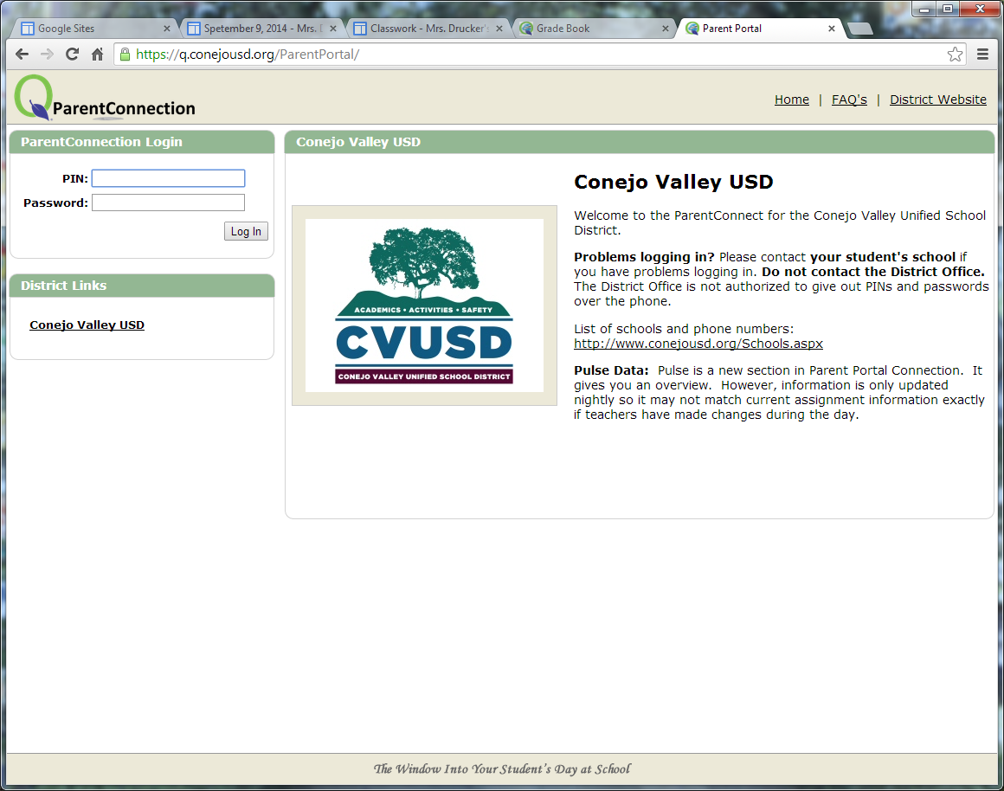
Zangle/Q Parent Connect
* Contact Front Office for Log In Information *

Slide 17
* Information about Miss Boutell & English/S.S. Classes * Daily Classwork & Homework (Downloads) * Supply Lists * Links to L.C. Website, Zangle/Q for Parents, L.C. Facebook, Instagram, Twitter… * Extra Handouts & Power Point Presentations * Useful Study Tools & Websites * Please encourage students to visit the website when they are absent so they can keep up with their work! ☺
Miss Boutell’s Website
www.aboutell.weebly.com

Slide 18
*Lunch *After School *Table Group Partner *Email *Absent files *Teachers Spiral
Extra Help

Slide 19
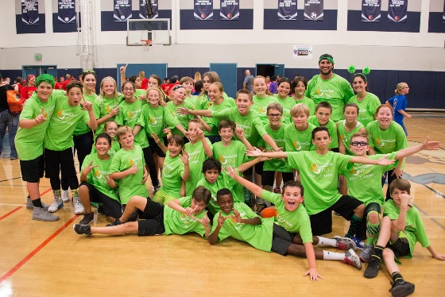
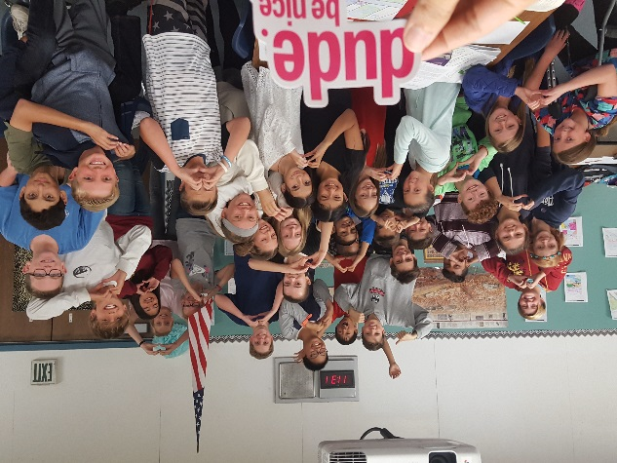
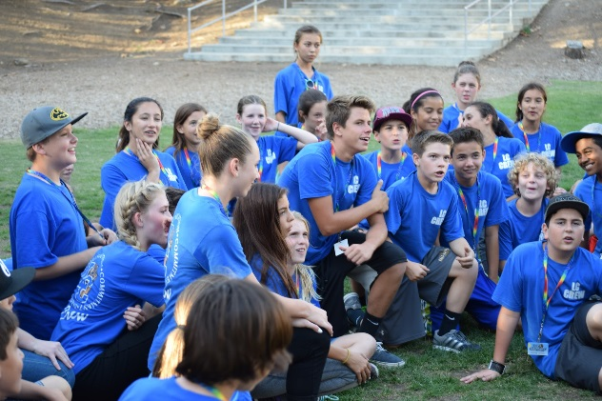
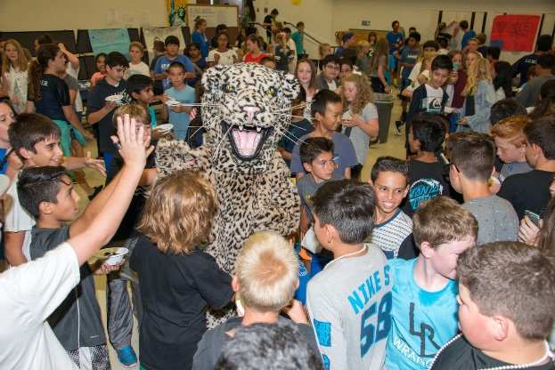
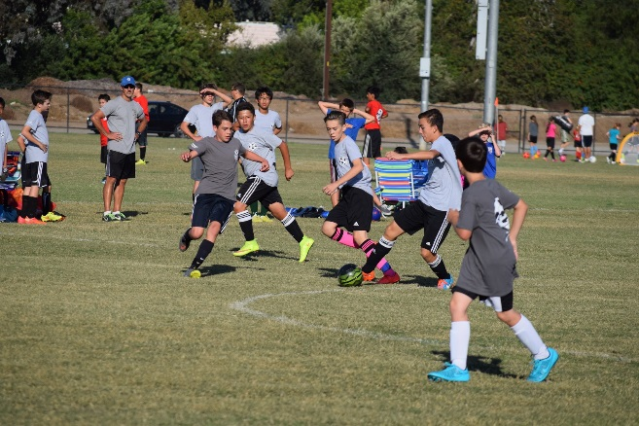
* Sport-O-Rama * Strings * Dances * Band * Builder’s Club * GATE * Leadership * Art * WEB * Woodshop * Boys & Girl’s Club * Sports * School Newspaper *Enrichments * Creative Writing Club * Choir
Get Involved!

Slide 20
Thank you for attending Back to School Night. It was a pleasure meeting all of you! ☺ I look forward to working with you and your child to make the transition to middle school a complete success.
THANK YOU!!!

Slide 21
Welcome to Back to School Night!
Miss Boutell
Room 31

Slide 22
Graded on effort not ability

Slide 23
*Picasso, Dali, Lichtenstein Pop Art, Monet, Van Gogh… *7 Elements of Art *Color Wheel Paintings *Zentangle *One and Two Point perspectives *Shading/Value *Quilling *Masks *Optical Illusions
Art Class

Slide 24
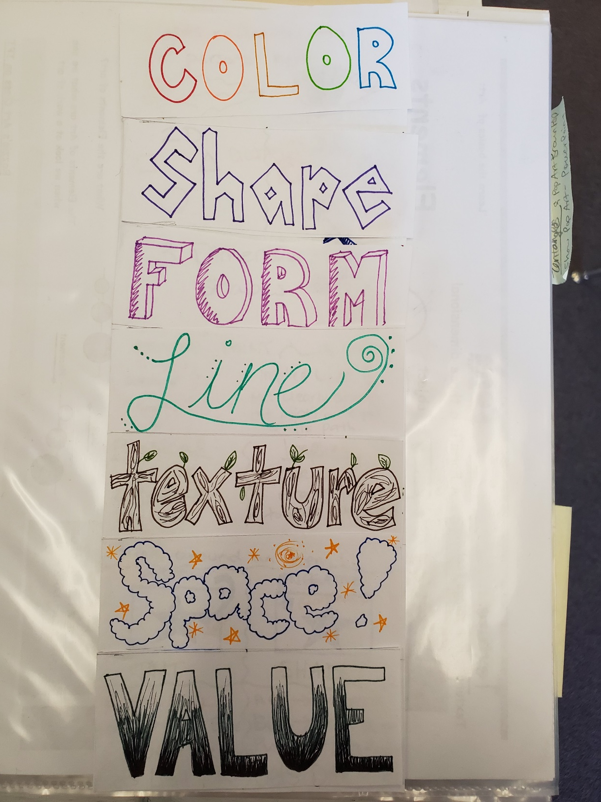

Slide 25
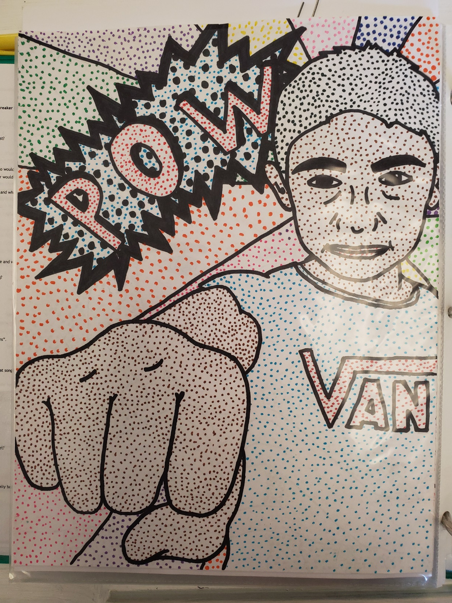

Slide 26
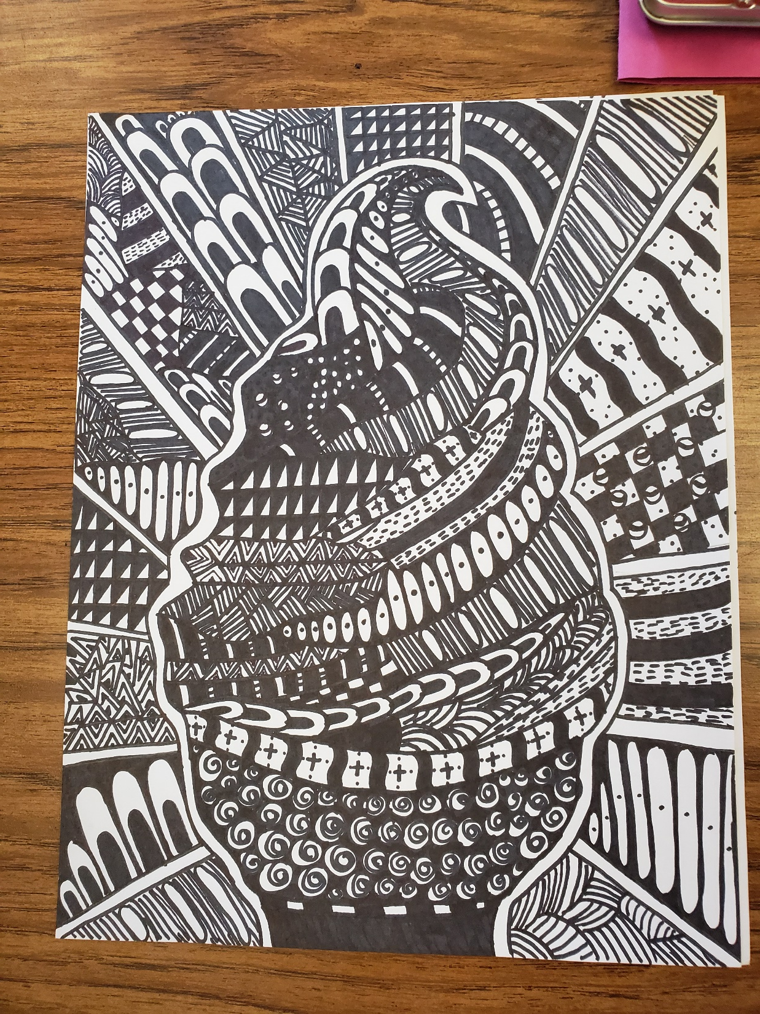

Slide 27
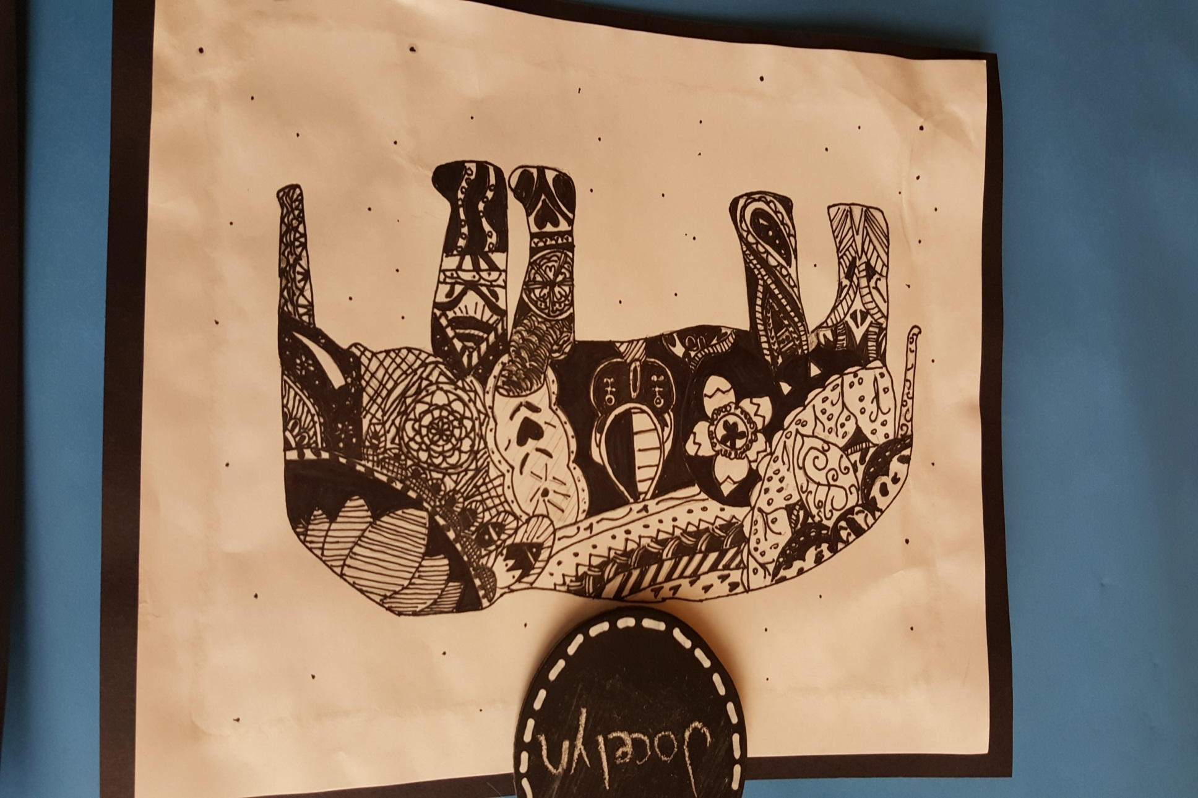
*

Slide 28
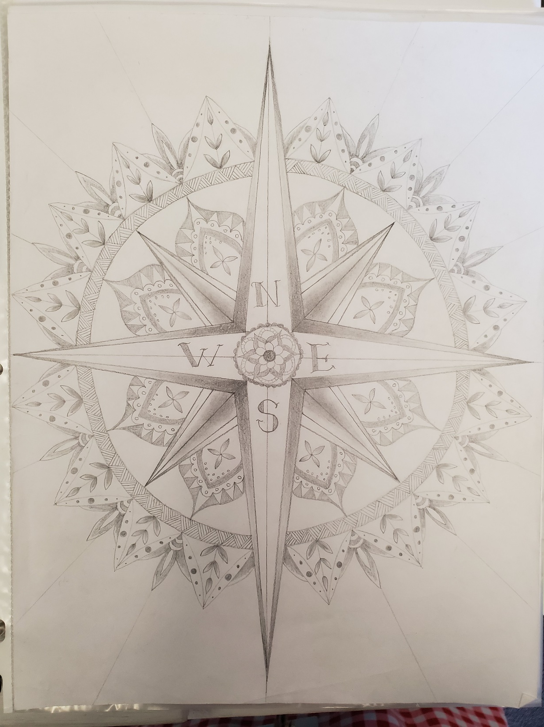

Slide 29
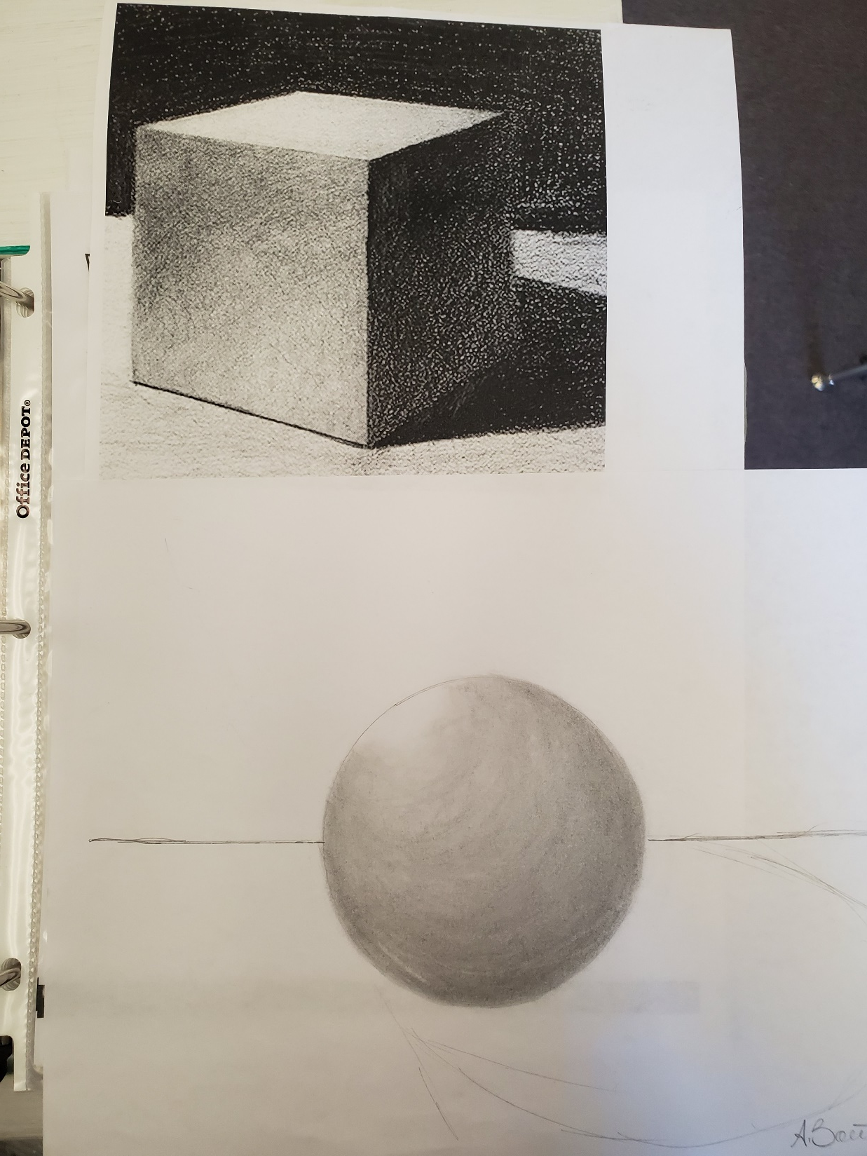

Slide 30
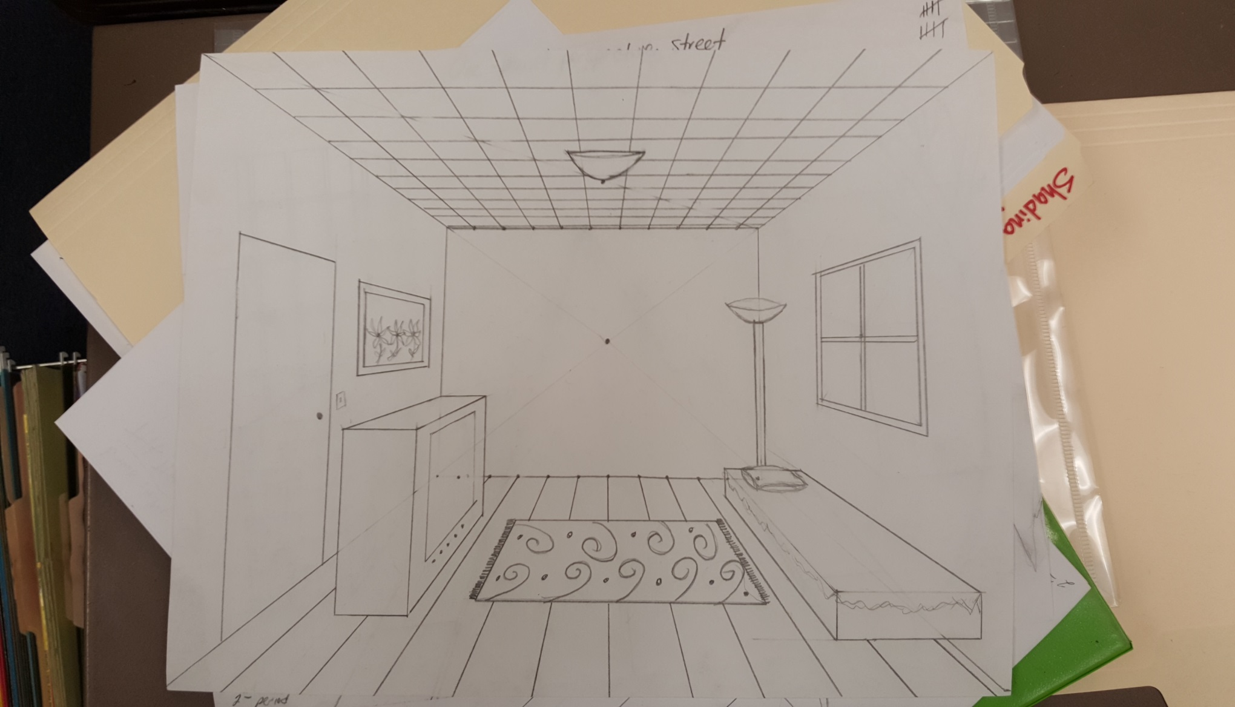

Slide 31
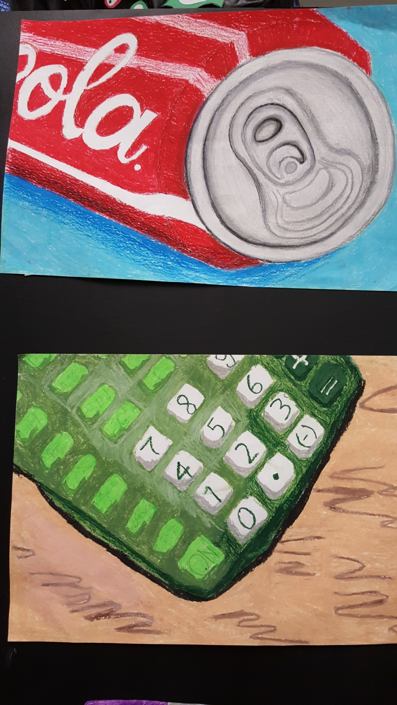
*

Slide 32
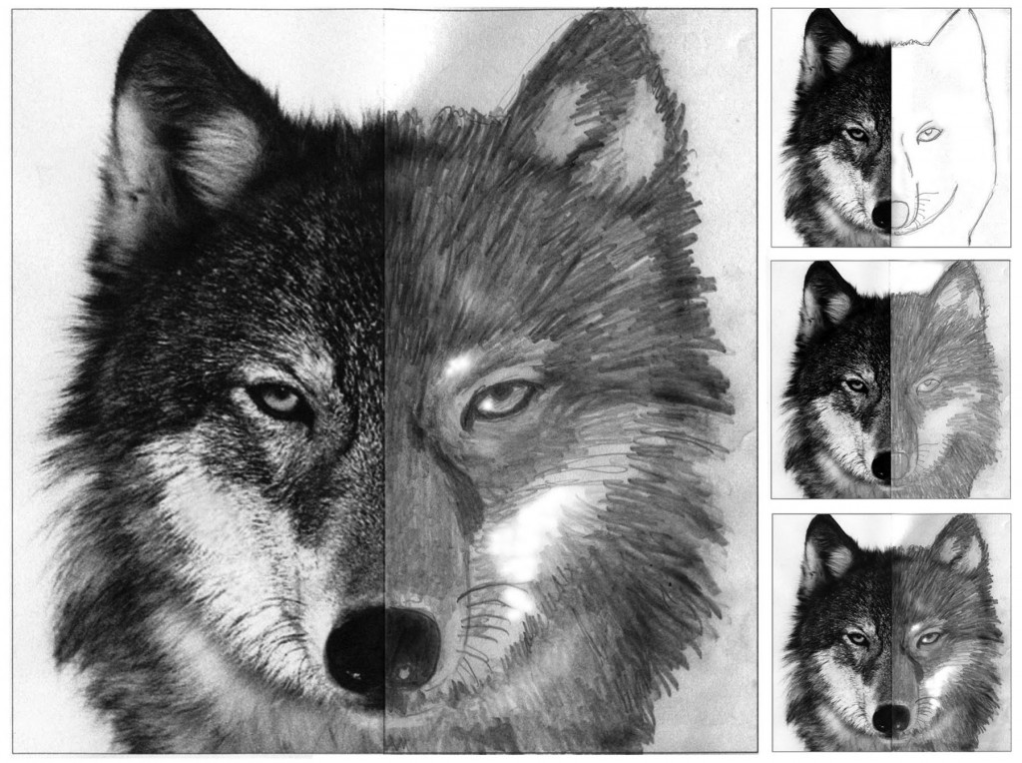

Slide 33
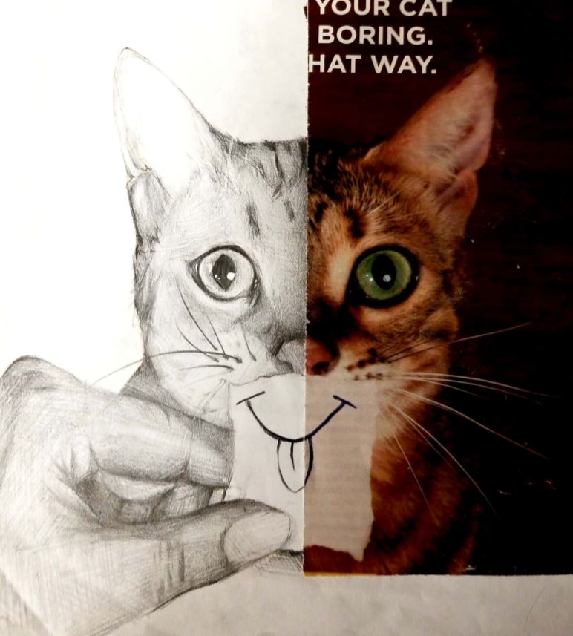

Slide 34
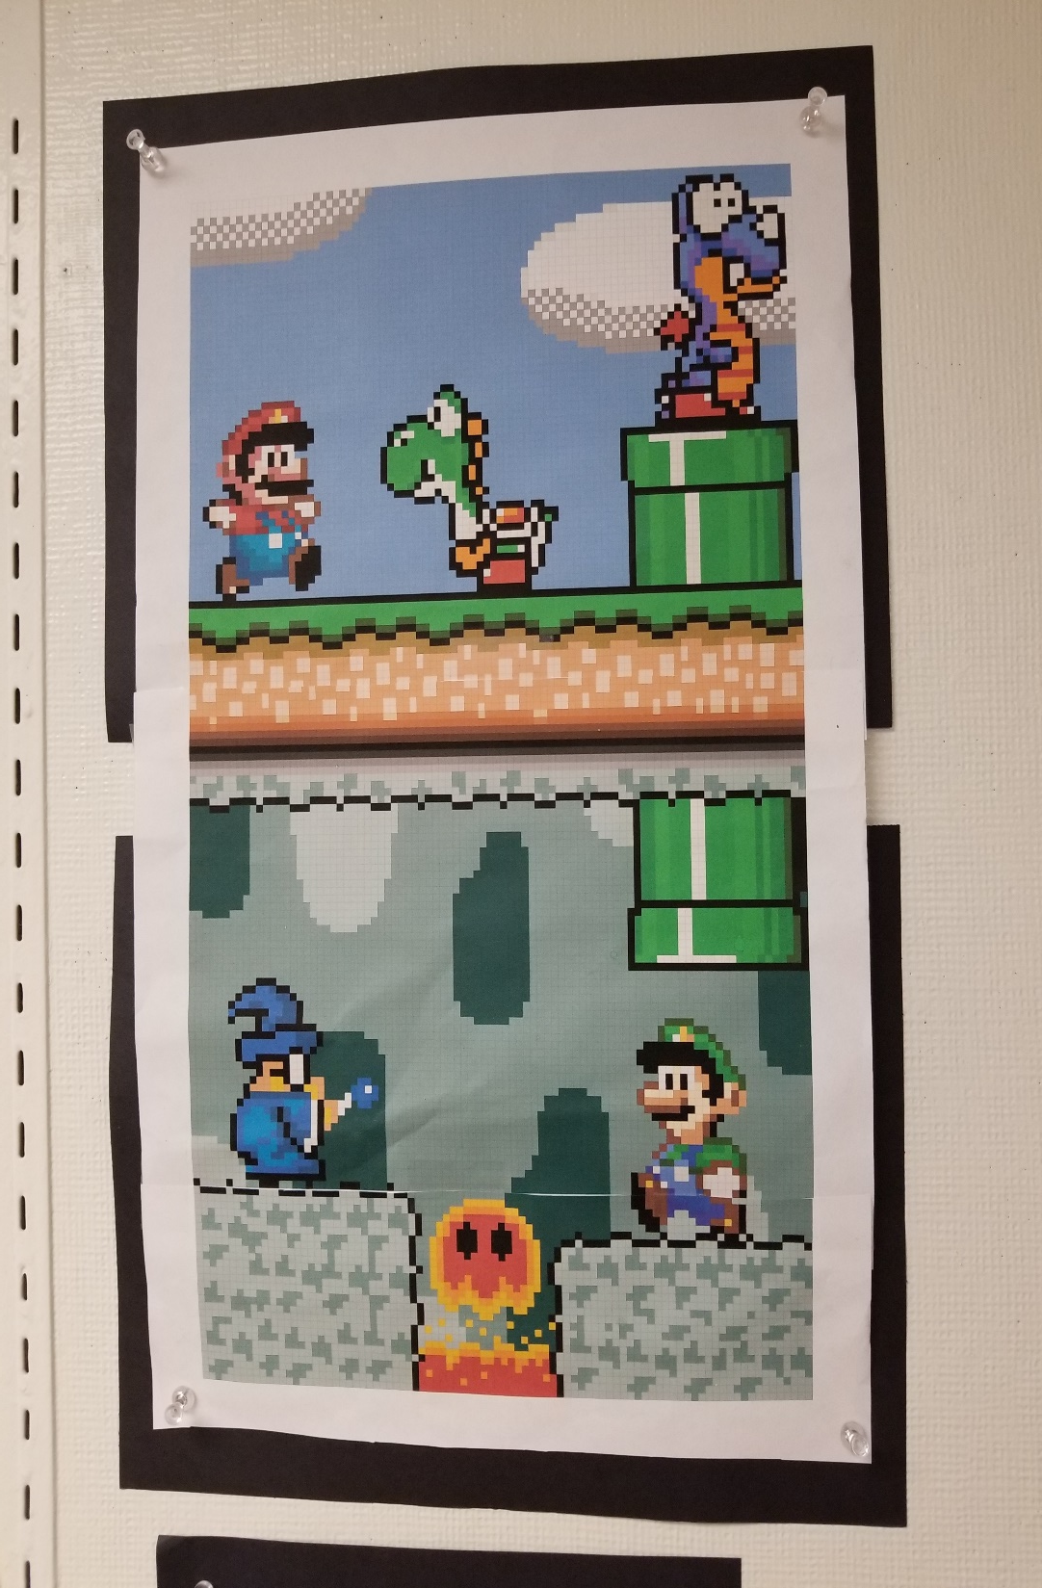
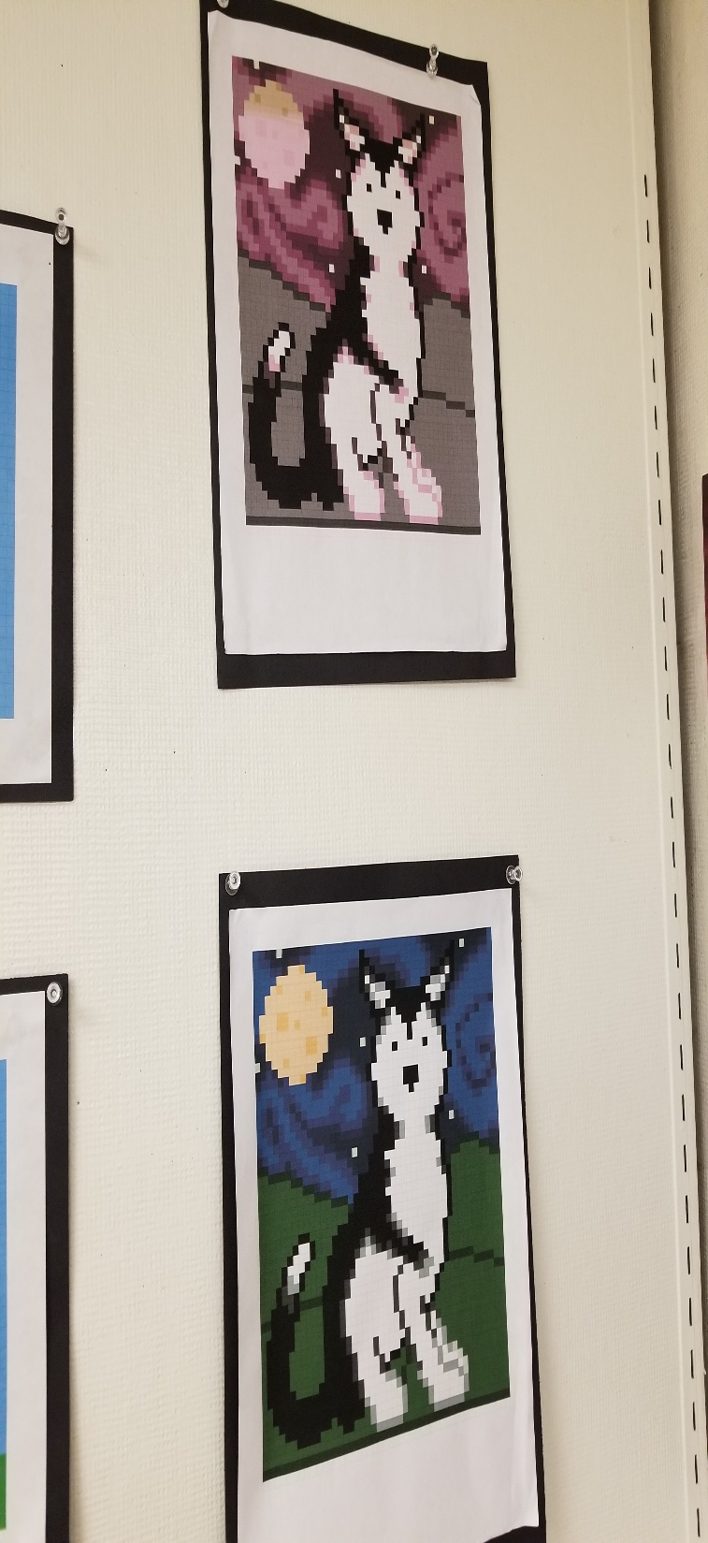
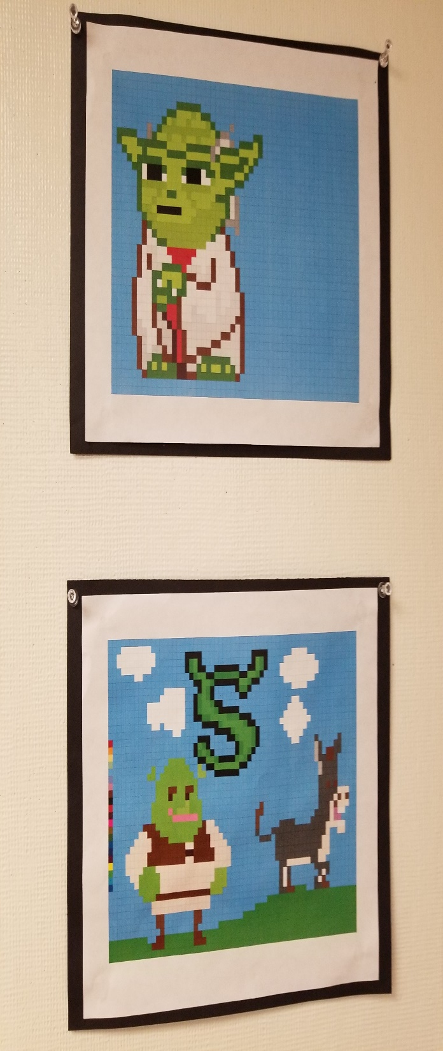

Slide 35
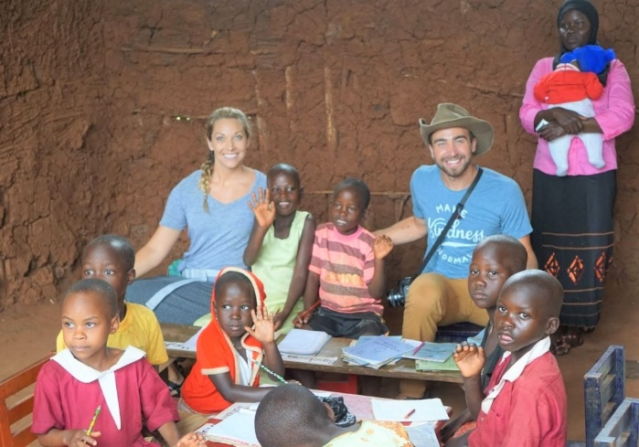
*Character Strong curriculum *empathy and kindness *human connection and teamwork *leadership skills *Learning strengths/Weaknesses *Organization/Time Management *Long and short Term Goals *Decision Making Skills *Note Taking *Test Taking *Study Skills
Character Building/ Study Skills

Slide 36
*Lunch *After School *Table Group Partner *Email *Absent Box *Teachers Spiral
Extra Help

Slide 37
Thank you for attending Back to School Night. It was a pleasure meeting all of you! ☺ I look forward to working with you and your child to make the transition to middle school a complete success.
THANK YOU!!!

